Slide 1
Data Preprocessing
Why preprocess the data?
Data integration and reduction
Discretization and concept hierarchy generation
Summary

Slide 2
Why Data Preprocessing?
Data in the real world is dirty
incomplete: lacking attribute values, lacking certain attributes of interest, or containing only aggregate data
e.g., occupation=“”
noisy: containing errors or outliers
e.g., Salary=“-10”
inconsistent: containing discrepancies in codes or names
e.g., Age=“42”, Birthday=“03/07/2008”
e.g., Was rating “1,2,3”, now rating “A, B, C”

Slide 3
Why Is Data Preprocessing Important?
No quality data, no quality mining results!
Quality decisions must be based on quality data
e.g., duplicate or missing data may cause incorrect or even misleading statistics
Data warehouse needs consistent integration of quality data

Slide 4
Multi-Dimensional Measure of Data Quality
Accuracy
Completeness
Consistency
Timeliness
Believability
Value added
Interpretability
Accessibility

Slide 5
Major Tasks in Data Preprocessing
Data cleaning
Fill in missing values, smooth noisy data, identify or remove outliers, and resolve inconsistencies
Data integration
Integration of multiple databases, data cubes, or files
Data transformation
Normalization and aggregation
Data reduction
Obtains reduced representation in volume but produces the same or similar analytical results
Data discretization
Part of data reduction but with particular importance, especially for numerical data

Slide 6
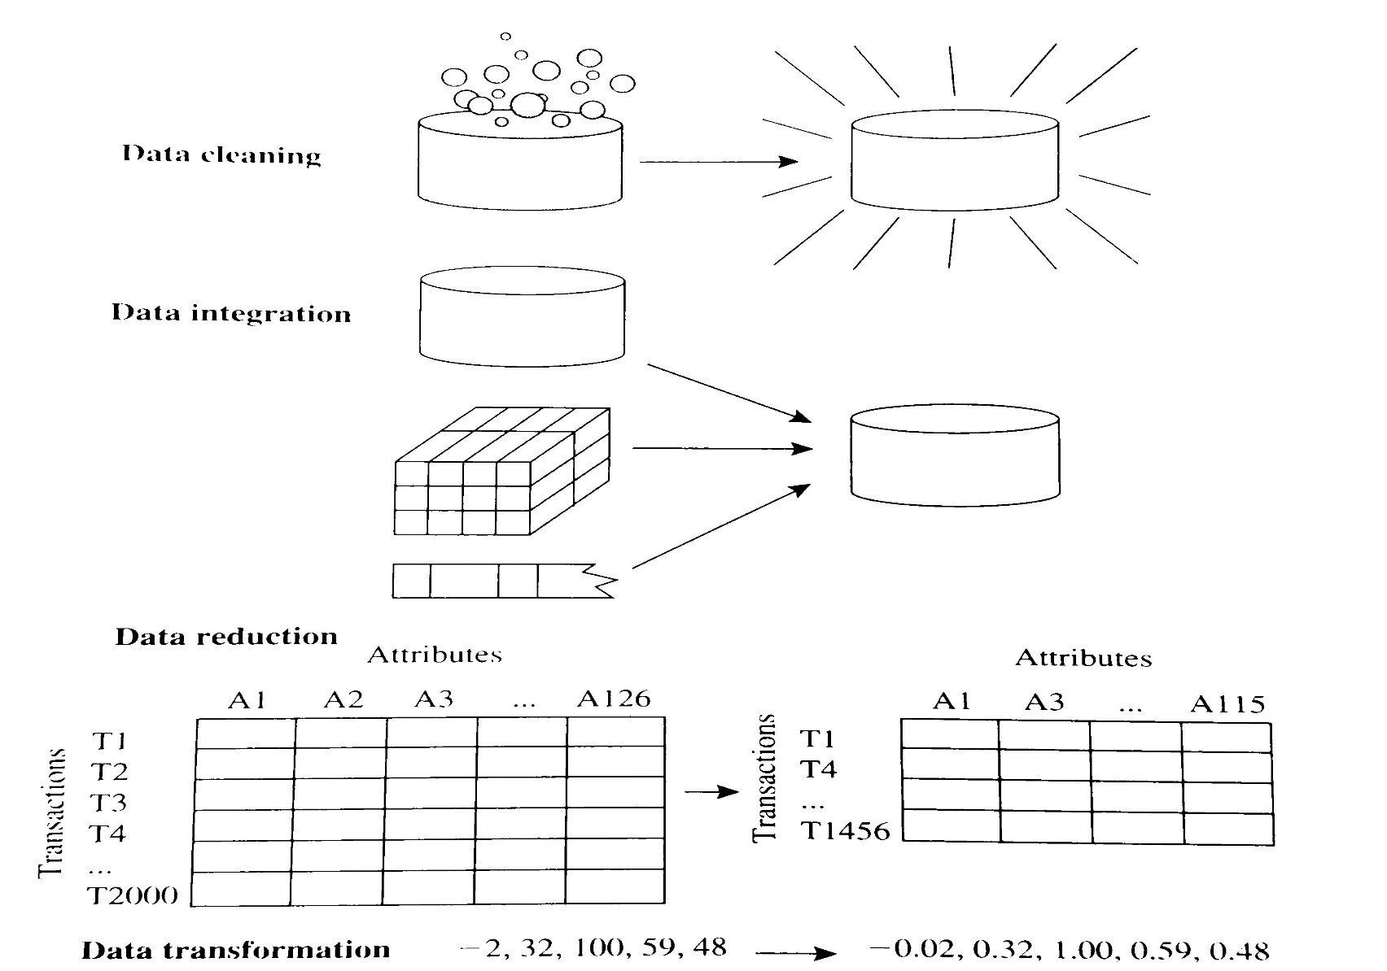
Tasks of data preprocessing

Slide 7
Handling Missing Data
Ignore the tuple: usually done when class label is missing (assuming the tasks in classification—not effective when the percentage of missing values per attribute varies considerably)
Fill in the missing value manually: tedious + infeasible?
Fill in it automatically with
a global constant : e.g., “unknown”, a new class?!
the attribute mean
the attribute mean for all samples belonging to the same class: smarter
the most probable value: inference-based such as Bayesian formula or decision tree

Slide 8
Data Integration
Data integration:
combine data from multiple sources into a coherent store
Schema integration
integrate metadata from different sources
entity identification problem: identify real world entities from multiple data sources, e.g., A.cust-id ≡ B.cust-#
Detecting and resolving data value conflicts
for the same real world entity, attribute values from different sources are different
possible reasons: different representations, different scales, e.g., metric vs. British units

Slide 9
Data Transformation
Smoothing: remove noise from data
Aggregation: summarization, data cube construction
Generalization: concept hierarchy
Normalization: scaled to fall within a small, specified range
min-max normalization
z-score normalization
normalization by log scaling
normalization by softmax function
Attribute/feature construction
New attributes constructed from the given ones

Slide 10
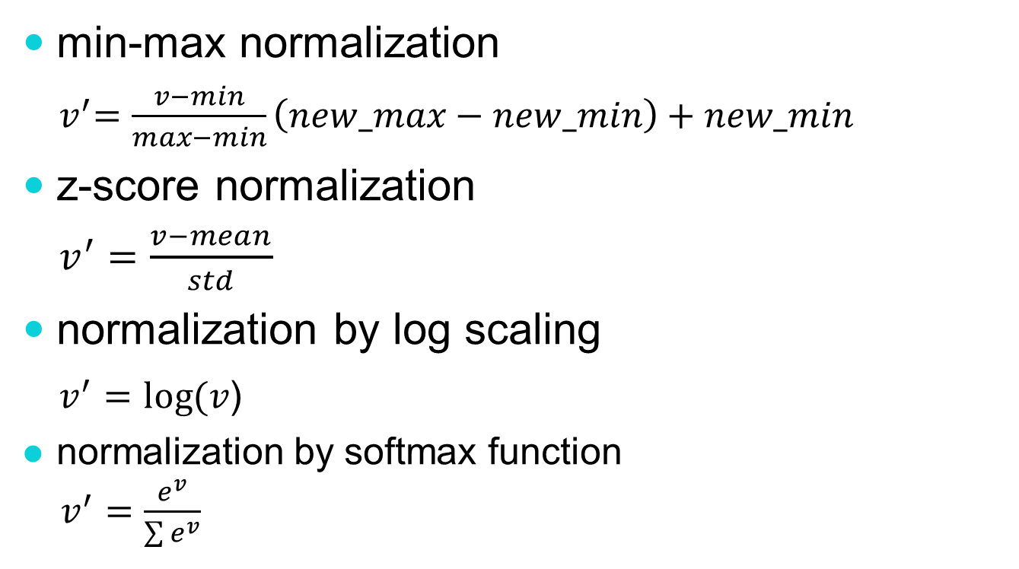
Data Transformation: Normalization
min-max normalization
${ v}^{′}=\frac{v−min}{max−min}\left(new_max−new_min\right)+new_min$
z-score normalization
$v^{′}=\frac{v−mean}{std}$
normalization by log scaling
$v^{′}=log⁡(v$)
normalization by softmax function
$v^{′}=\frac{e^{v}}{\sum{e^{v}}}$
Notes:
The output of softmax normalization is always positive (regardless of whether vi is positive or negative. Using exponentiation can give greater separation than a linear transformation.
The softmax normalization increases the normalized value of the highest one and decrease those of the lower ones when compared with min-max normalization.
The hardmax normalization (using argmax function) transforms the highest value into 1 and the rest into 0.

Slide 11

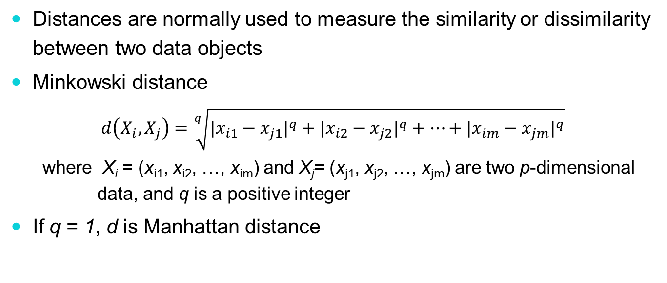
Minkowski distance
Distances are normally used to measure the similarity or dissimilarity between two data objects
Minkowski distance
$$d\left(X_{i},X_{j}\right)=\sqrt[q]{{|x_{i1}−x_{j1}|}^{q}+{|x_{i2}−x_{j2}|}^{q}+…+{|x_{im}−x_{jm}|}^{q}}$$
where X_{i} = (x_{i1}, x_{i2}, …, x_{im}) and X_{j}= (x_{j1}, x_{j2}, …, x_{jm}) are two p-dimensional data, and q is a positive integer
If q = 1, d is Manhattan distance
$$d(X_{i},X_{j})=|x_{i1}−x_{j1}|+|x_{i2}−x_{j2}|+...+|x_{im}−x_{jm}|$$

Slide 12
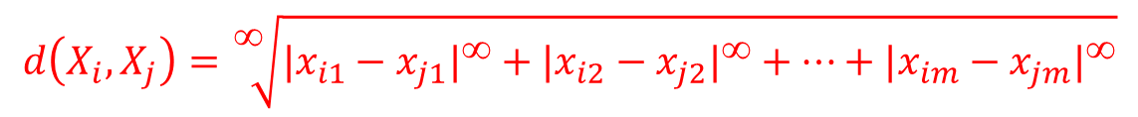
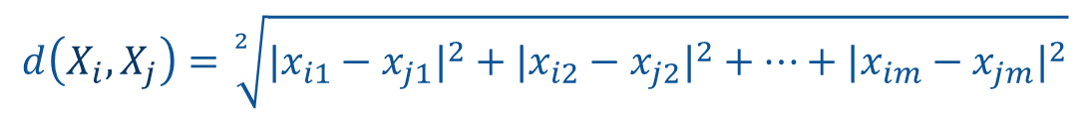
q=∞
q=1
q=2
$$d\left(X_{i},X_{j}\right)=\sqrt[2]{{|x_{i1}−x_{j1}|}^{2}+{|x_{i2}−x_{j2}|}^{2}+…+{|x_{im}−x_{jm}|}^{2}}$$
$$d\left(X_{i},X_{j}\right)=|x_{i1}−x_{j1}|+|x_{i2}−x_{j2}|+…+|x_{im}−x_{jm}|$$
$$d\left(X_{i},X_{j}\right)=\sqrt[∞]{{|x_{i1}−x_{j1}|}^{∞}+{|x_{i2}−x_{j2}|}^{∞}+…+{|x_{im}−x_{jm}|}^{∞}}$$

Slide 13

Minkowski distance (q=∞)
$$d\left(X_{i},X_{j}\right)=\sqrt[q]{{|x_{i1}−x_{j1}|}^{q}+{|x_{i2}−x_{j2}|}^{q}+…+{|x_{im}−x_{jm}|}^{q}}$$
$$\lim_{q→∞}{\sqrt[q]{{\left|x_{i1}−x_{j1}\right|}^{q}[{\left(\frac{\left|x_{i1}−x_{j1}\right|}{\left|x_{i1}−x_{j1}\right|}\right)}^{q}+{\left(\frac{\left|x_{i2}−x_{j2}\right|}{\left|x_{i1}−x_{j1}\right|}\right)}^{q}+…+{\left(\frac{\left|x_{im}−x_{jm}\right|}{\left|x_{i1}−x_{j1}\right|}\right)}^{q}]}}$$
=1 <1 … <1
→0 … →0
$$=\lim_{q→∞}{\sqrt[q]{{\left|x_{i1}−x_{j1}\right|}^{q}}=\left|x_{i1}−x_{j1}\right|}$$

Slide 14
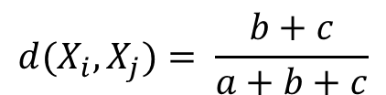
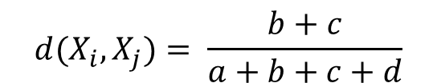

Distance between Binary Variables
X_{j}
A contingency table for binary data
Distance measure for symmetric binary variables:
Distance measure for asymmetric binary variables:
Jaccard coefficient (similarity measure for asymmetric binary variables):
X_{i}
$$d(X_{i},X_{j})= \frac{b+c}{a+b+c+d}$$
$$d(X_{i},X_{j})= \frac{b+c}{a+b+c}$$
$$sim_{Jaccard}(X_{i},X_{j})= \frac{a}{a+b+c}$$

Slide 15


Slide 16

Distance between Binary Variables
Example
gender is a symmetric attribute
the remaining attributes are asymmetric binary
let the values Y and P be set to 1, and the value N be set to 0
$$d(jack,mary)=\frac{0+1}{2+0+1}=0.33 \\ d(jack,jim)=\frac{1+1}{1+1+1}=0.67 \\ d(jim,mary)=\frac{1+2}{1+1+2}=0.75$$

Slide 17

Distance between Nominal Variables
名目變數（Nominal Variables）之間的距離計算方法，這種變數是非數值的、沒有順序的分類資料，例如髮色、國籍、血型等。
A generalization of the binary variable in that it can take more than 2 states, e.g., brown, golden, white, grey, black (color of hair)
Method 1: Simple matching
k: # of matches, p: total # of variables
Method 2: use a large number of binary variables
creating a new binary variable for each of the M nominal states (One-hot encoding)
$$d(X_{i},X_{j})=\frac{p−k}{p}$$

Slide 18

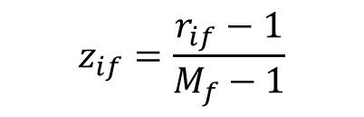
Distance between Ordinal Variables
序數變數（Ordinal Variables）之間的距離怎麼計算。序數變數是一種有順序但沒有確切間距大小的資料，例如滿意度等級（滿意、普通、不滿意）、教育程度（小學、國中、高中、大學）等。
An ordinal variable can be discrete or continuous
Order is important, e.g., rank
Can be treated like interval-scaled
replace x_{if} by their rank
map the range of each variable onto [0, 1] by replacing i-th object in the f-th variable by
compute the dissimilarity using methods for interval-scaled variables
$$r_{if}∈\{1,...,M_{f}\}$$
$$z_{if}=\frac{r_{if}−1}{M_{f}−1}$$

Slide 19
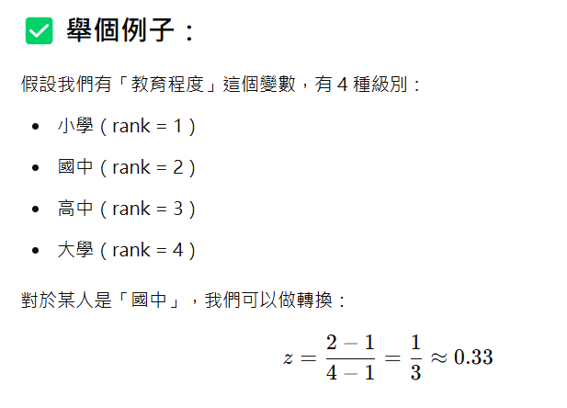
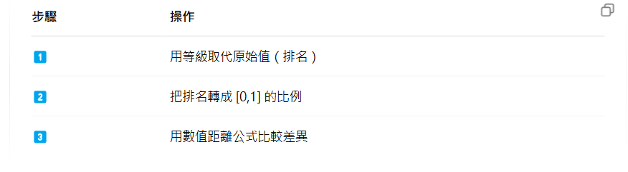

Slide 20
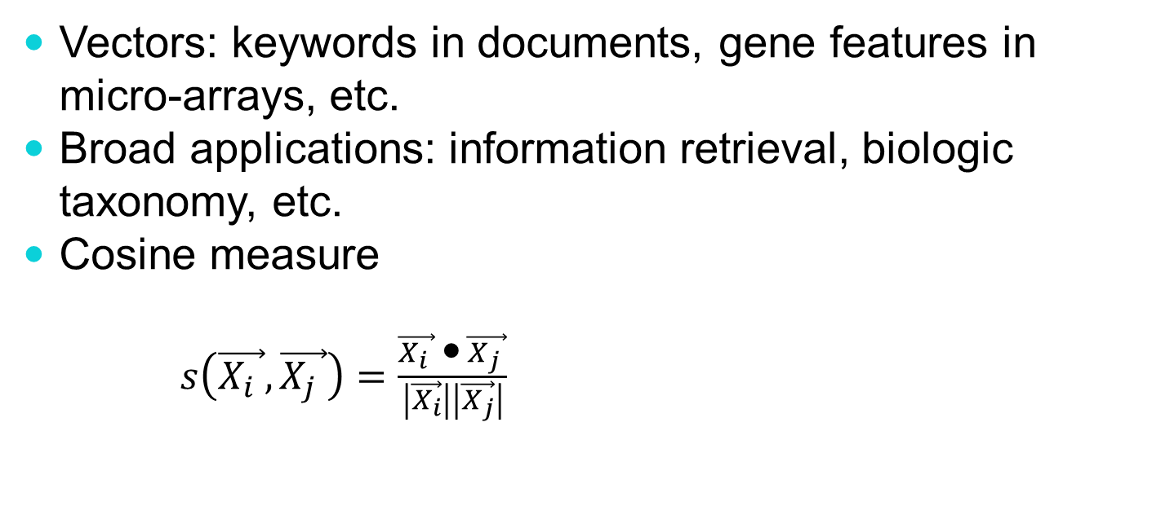
Similarity between Vectors
Vectors: keywords in documents, gene features in micro-arrays, etc.
Broad applications: information retrieval, biologic taxonomy, etc.
Cosine measure
$s\left(\vec{X_{i} },\vec{X_{j} }\right)=\frac{\vec{X_{i} } • \vec{X_{j} }}{\left|\vec{X_{i}}\right|\left|\vec{X_{j}}\right|}$

Slide 21
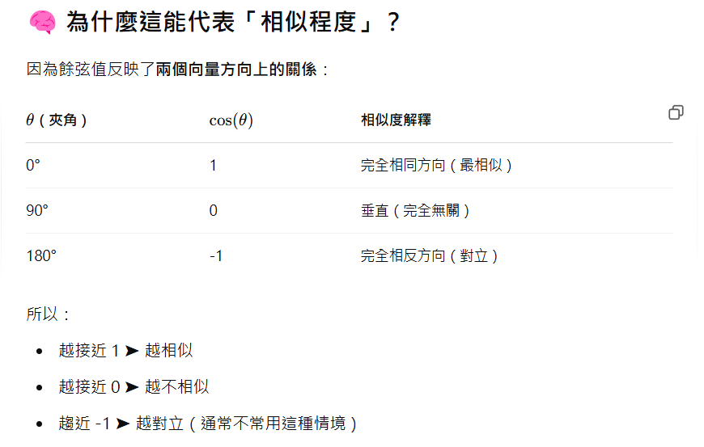
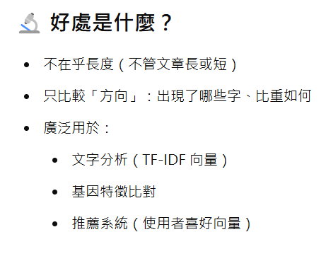

Slide 22
Data Reduction Strategies
Data reduction
Obtain a reduced representation of the data set that is much smaller in volume but yet produce the same (or almost the same) analytical results
Data reduction strategies
Dimensionality reduction—remove unimportant attributes
Data compression
Numerosity reduction—fit data into models
Discretization and concept hierarchy generation

Slide 23
Dimensionality Reduction
Feature selection (i.e., attribute subset selection):
Select a minimum set of features such that the probability distribution of different classes given the values for those features is as close as possible to the original distribution given the values of all features
reduce # of patterns in the patterns, easier to understand
Heuristic methods (due to exponential # of choices):
step-wise forward selection
step-wise backward elimination
combining forward selection and backward elimination
decision-tree induction

Slide 24
Reduce by Decision Tree
Initial attribute set:
{A1, A2, A3, A4, A5, A6}
A4 ?
A1?
A6?
Class 1
Class 2
Class 1
Class 2
Reduced attribute set: {A1, A4, A6}

Slide 25
Principal Component Analysis
Given M data vectors of N dimensions, find c <= N orthogonal vectors that can be best used to represent data
The original data set is reduced to one consisting of M data vectors on c principal components (reduced dimensions)
Each data vector is a linear combination of the principal component vectors
Works for numeric data only
Used when the number of dimensions is large
Notes:
I eat fish and vegetables.
Fish are pets.
My kitten eats fish.

Slide 26
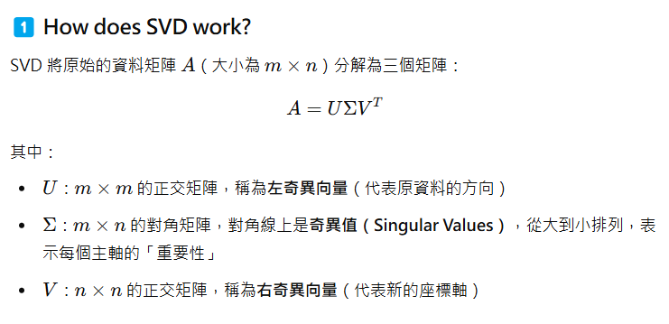
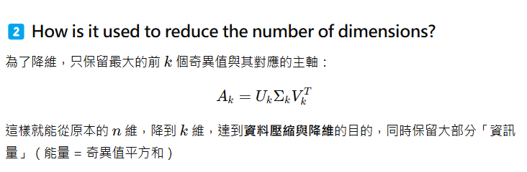

Slide 27
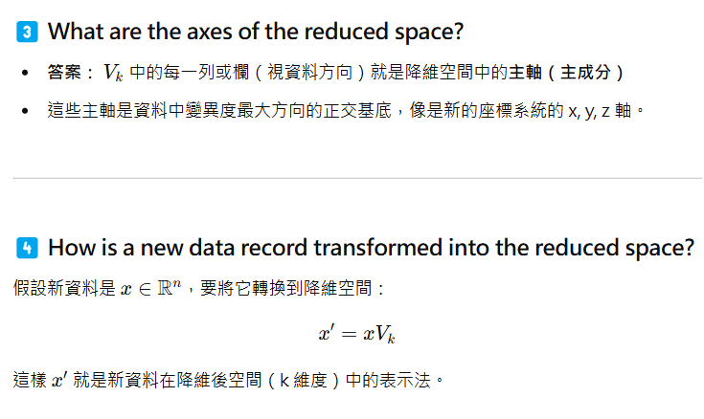

Slide 28
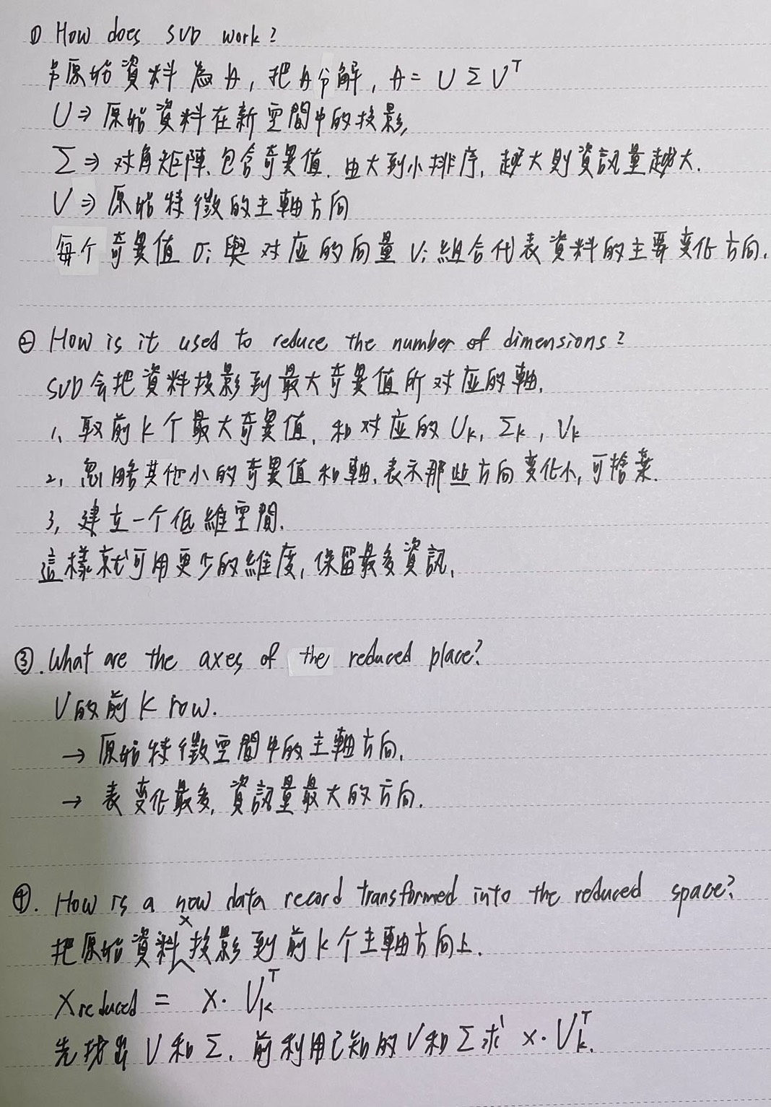

Slide 29
Singular Value Decomposition (SVD)
Intuition: find the axis that shows the greatest variation, and project all points into this axis
X2
Y1
Y2
X1

Slide 30
SVD
Let A be the M x N matrix of M N-dimensional points
SVD decomposition
A= U x Λ x V^{T}
AA^{T} = (U x Λ x V^{T} ) (U x Λ x V^{T} )^{T}= U x Λ x Λ^{T} x U^{T}
A^{T}A = (U x Λ x V^{T} ) ^{T} (U x Λ x V^{T} ) = V x Λ^{T} x Λ x V^{T}
U(M x M)
U is orthogonal: U^{T}U = I
columns of U are the orthogonal eigenvectors of AA^{T}
called the left singular vectors of A
Notes:
V is a matrix of eigenvectors (each column is an eigenvector) and Lamda is a diagonal matrix with eigenvalues λiλi in the decreasing order on the diagonal. The eigenvectors are called principal axes or principal directions of the data. Projections of the data on the principal axes are called principal components, also known as PC scores; these can be seen as new, transformed, variables. The j-th principal component is given by j-th column of AVT. The coordinates of the i-th data point in the new PC space are given by the i-th row of A=UXVT.

Slide 31
SVD
V(N x N)
V is orthogonal: V^{T}V = I
columns of V are the orthogonal eigenvectors of A^{T}A
called the right singular vectors of A
Λ(M x N)
diagonal matrix consisting of r non-zero values in descending order
the eigenvalues of AA^{T} (or A^{T}A)
r is the rank of the symmetric matrices
called the singular values

Slide 32
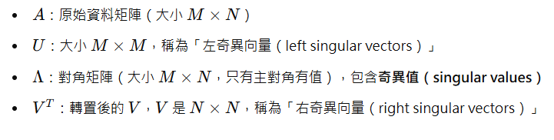
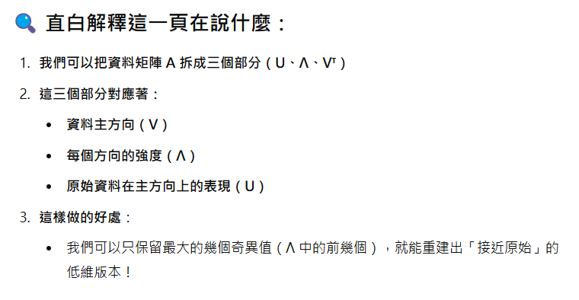
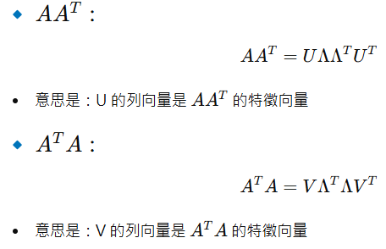

Slide 33
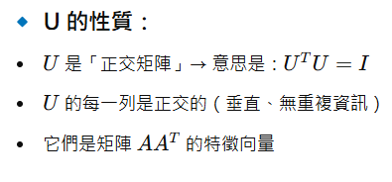
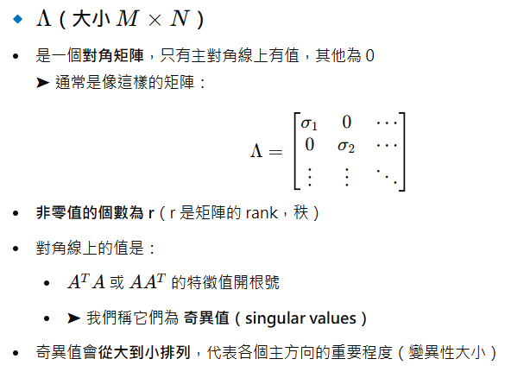
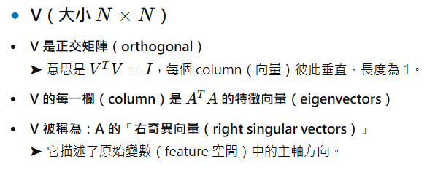

Slide 34
SVD - Interpretation
 | Wed | Thu | Fri | Sat | Sun
Alice | 1 | 1 | 1 | 0 | 0
Bob | 2 | 2 | 2 | 0 | 0
Candy | 1 | 1 | 1 | 0 | 0
David | 5 | 5 | 5 | 0 | 0
Ethan | 0 | 0 | 0 | 2 | 2
Frank | 0 | 0 | 0 | 3 | 3
Grace | 0 | 0 | 0 | 1 | 1

Slide 35
SVD - Interpretation
A = U Λ V^{T} - example:
=
x
x
v1

Slide 36
SVD - Interpretation
A = U Λ V^{T} - example:
variance (‘spread’) on the v1 axis
=
x
x

Slide 37
SVD - Interpretation
A = U Λ V^{T} - example:
AV=U L gives the coordinates of the points in the projected space
≈
x
x

Slide 38
Dimensionality reduction
A heuristic: keep 80-90% of ‘energy’ (= sum of squares of λ_{i} ’s)
N
=
λ₁
u₁
v^{T}₁
+
λ₂
u₂
v^{T}₂
+...
M
where λ₁ >= λ₂ >= ...

Slide 39
Dimensionality reduction
Matrix V in the SVD decomposition
(A = UΛV^{T} ) is used to transform the data.
AV (= UΛ) defines the transformed dataset.
For a new data element x, xV defines the transformed data.
Keeping the first c (c < N) dimensions, amounts to keeping only the first c rows of V^{T}.

Slide 40
Principal Components Analysis (PCA)
Transfer the dataset to the center by subtracting the means: let matrix A be the result.
Compute the matrix A^{T}A.
The covariance matrix except for constants.
Project the dataset along a subset of the eigenvectors of A^{T}A.
Matrix V in the SVD decomposition
(A= U Λ V^{T} ) contains the eigenvectors of A^{T}A.
Also known as K-L (Karhunen-Loeve) transform.

Slide 41
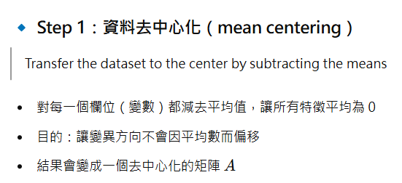
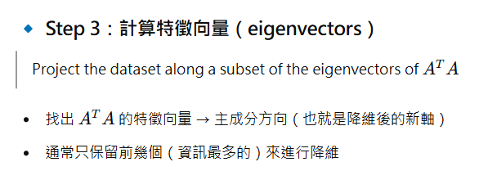
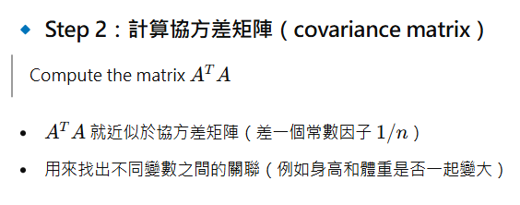
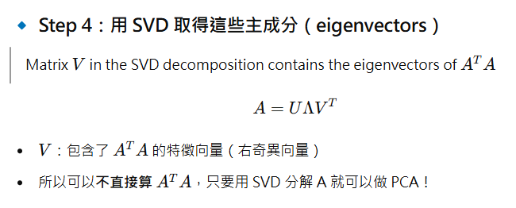

Slide 42


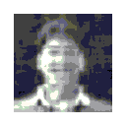
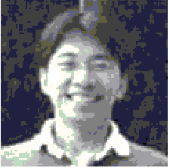
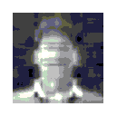
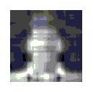


100 pixels
U
Λ
V^{T}
100 pixels
=
100%
20 %
10 %
5 %
Λ為一個對角矩陣。
左上到右下由大到小排列
右邊8張圖，為UΛV還原時
Λ保留值的百分比
如20%這張圖
從21~100的
eigenvalues被設為0
4%
3%
2%
1%

Slide 43
Latent Semantic Analysis (LSA, LSI)
Consider a term-document matrix
 | ship | boat | ocean | voyage | trip
d1 | 1 | 0 | 1 | 1 | 0
d2 | 0 | 1 | 1 | 0 | 0
d3 | 1 | 0 | 0 | 0 | 0
d4 | 0 | 0 | 0 | 1 | 1
d5 | 0 | 0 | 0 | 1 | 0
d6 | 0 | 0 | 0 | 0 | 1
A

Slide 44
LSA (Cont.)
 | 1 | 2 | 3 | 4 | 5 | 6
d1 | 0.75 | -0.29 | -0.28 | 0.00 | 0.53 | 0.00
d2 | 0.28 | -0.53 | 0.75 | 0.00 | -0.29 | 0.00
d3 | 0.20 | -0.19 | -0.45 | 0.58 | -0.63 | 0.00
d4 | 0.45 | 0.63 | 0.20 | 0.00 | -0.19 | -0.58
d5 | 0.33 | 0.22 | -0.12 | -0.58 | -0.41 | 0.58
d6 | 0.12 | 0.41 | 0.33 | 0.58 | 0.22 | 0.58
 | 1 | 2 | 3 | 4 | 5
1 | 2.16 | 0.00 | 0.00 | 0.00 | 0.00
2 | 0.00 | 1.59 | 0.00 | 0.00 | 0.00
3 | 0.00 | 0.00 | 1.28 | 0.00 | 0.00
4 | 0.00 | 0.00 | 0.00 | 1.00 | 0.00
5 | 0.00 | 0.00 | 0.00 | 0.00 | 0.39
6 | 0.00 | 0.00 | 0.00 | 0.00 | 0.00
Λ
U
 | ship | boat | ocean | voyage | trip
1 | 0.44 | 0.13 | 0.48 | 0.70 | 0.26
2 | -0.29 | -0.33 | -0.51 | 0.35 | 0.65
3 | -0.57 | 0.59 | 0.37 | -0.15 | 0.41
4 | 0.58 | 0.00 | 0.00 | -0.58 | 0.58
5 | -0.25 | -0.73 | 0.61 | -0.16 | 0.09
V^{T}
Notes:
{u,w,v}=N[SingularValueDecomposition[{{1,0,1,1,0},{0,1,1,0,0},{1,0,0,0,0},{0,0,0,1,1},{0,0,0,1,0},{0,0,0,0,1}}]] (Mathematica)

Slide 45
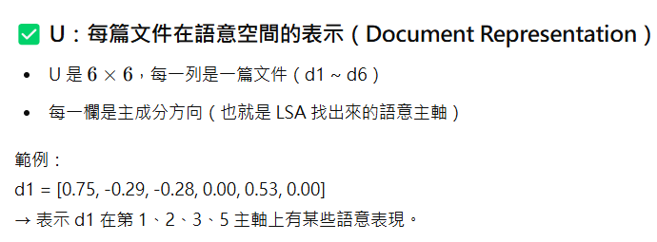
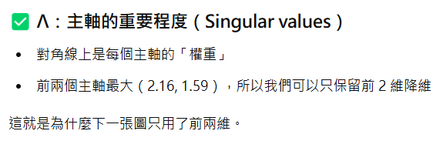
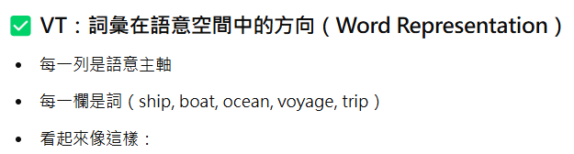


Slide 46
LSA (Cont.)
 | 1 | 2
d1 | 1.62 | -0.45
d2 | 0.61 | -0.84
d3 | 0.44 | -0.29
d4 | 0.96 | 1.00
d5 | 0.70 | 0.35
d6 | 0.26 | 0.65
d4
d6
d5
d3
d1
d2
Notes:
A2=u*w’, where w’ is obtained by setting the last three eigenvalues of w to 0.

Slide 47
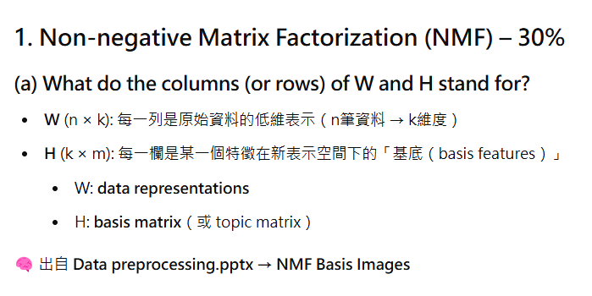

Slide 48
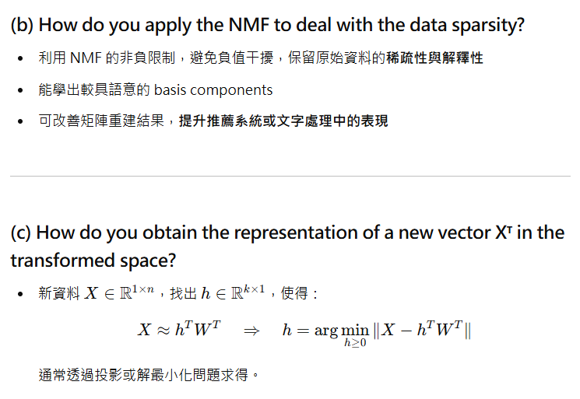

Slide 49
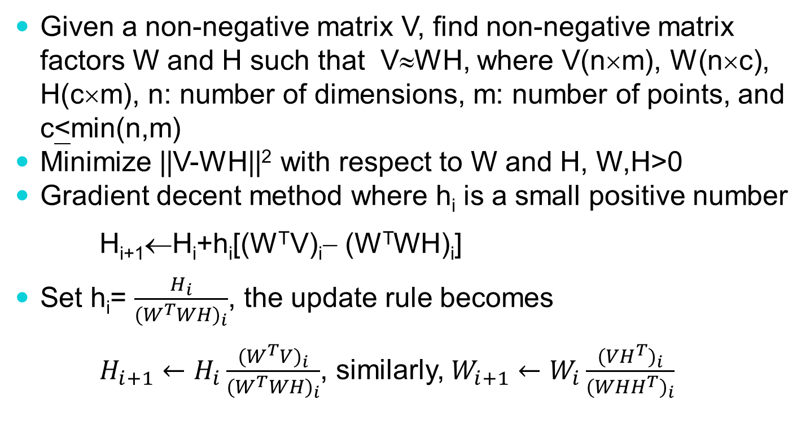
Non-negative Matrix Factorization (NMF)
Given a non-negative matrix V, find non-negative matrix factors W and H such that V≈WH, where V(n×m), W(n×c), H(c×m), n: number of dimensions, m: number of points, and c<min(n,m)
Minimize ||V-WH||² with respect to W and H, W,H>0
Gradient decent method where h_{i} is a small positive number
H_{i+1}←H_{i}+h_{i}[(W^{T}V)_{i}− (W^{T}WH)_{i}]
Set h_{i}= $\frac{H_{i}}{{(W^{T}WH)}_{i}}$, the update rule becomes
$H_{i+1}←H_{i}\frac{{(W^{T}V)}_{i}}{{(W^{T}WH)}_{i}}$, similarly, $W_{i+1}←W_{i}\frac{{({VH}^{T})}_{i}}{{({WHH}^{T})}_{i}}$
Notes:
The update rule is implemented by element-wise matrix multiplication and division.
This is a multiplicative update instead of an additive update.
If the initial values of W and H are all non-negative, then the W and H can never become negative.
This lets us produce a non-negative factorization
KL-divergence is usually a more accurate way to compare probability distributions.
# Transform new_feedback to NMF space nmf_new_feedback = clf.transform(vectorizer.fit(new_feedback))
in each step of such an algorithm, first H is fixed and W found by a non-negative least squares solver, then W is fixed and H is found analogously

Slide 50
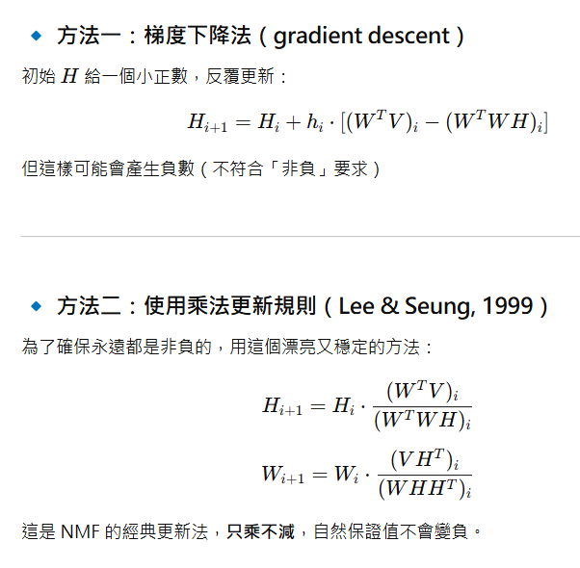

Slide 51
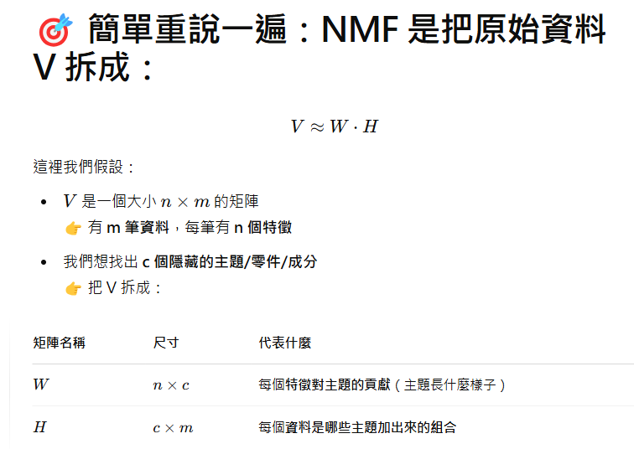

Slide 52
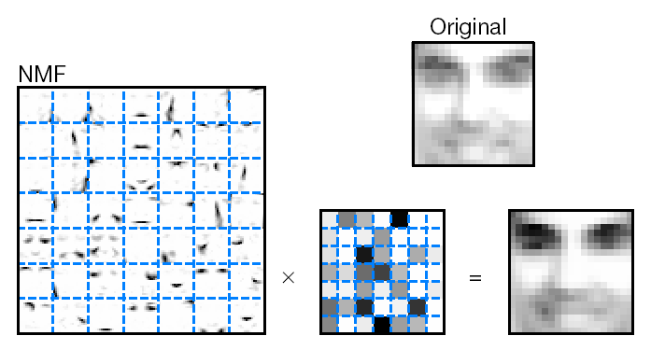
NMF
Like PCA, except the coefficients in the linear combination cannot be negative, where each image is of size 19*19, V(361 × 2429), c=49
Notes:
m = 2429 facial images
Each image of size n = 19 by 19 = 361
Matrix V = n by m is the original dataset
We want to approximate V by two lower rank matrix W (n by 49) and H (49 by m)

Slide 53
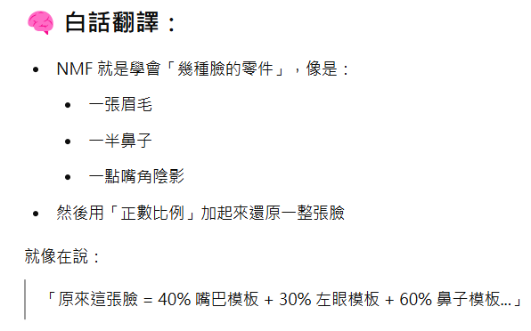


Slide 54
NMF Basis Images (Bases)
Only allowing adding of basis images makes intuitive sense
Forcing the reconstruction coefficients to be positive leads to nice basis images
To reconstruct images, all you can do is add in more basis images
This leads to basis images that represent parts

Slide 55
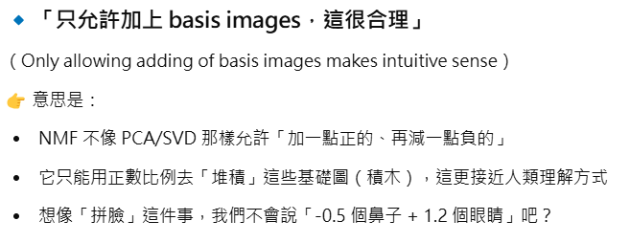


Slide 56



Slide 57
Filling zero-entries
Recommendation
 | M1 | M2 | M3 | M4
U1 | 5 | 3 | - | 1
U2 | 4 | - | - | 1
U3 | 1 | 1 | - | 5
U4 | 1 | - | - | 4
U5 | - | 1 | 5 | 4
 | M1 | M2 | M3 | M4
U1 | 4.97 | 2.98 | 2.18 | 0.98
U2 | 3.97 | 2.40 | 1.97 | 0.99
U3 | 1.02 | 0.93 | 5.32 | 4.93
U4 | 1.00 | 0.85 | 4.59 | 3.93
U5 | 1.36 | 1.07 | 4.89 | 4.12

Slide 58





Autoencoder
Autoencoder uses activation functions to achieve non-linear mapping
Can be used for dimensionality reduction and feature learning
May have multiple hidden layers
As close as possible
encode
decode
$$x$$
$$z$$
$$\hat{x}$$
$$W$$
$$W^{T}$$
Input layer
hidden layer
output layer
Z is the encoded code
Notes:
A neutral net whose output tries to reconstruct the input
Target of output ($\hat{y}$) = input ($x$)

Slide 59
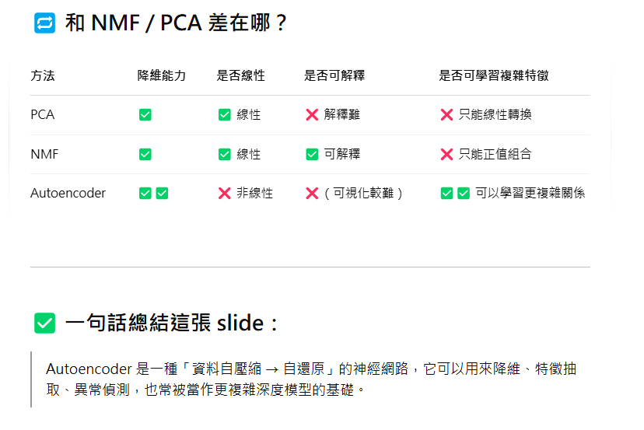

Slide 60



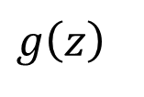
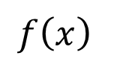

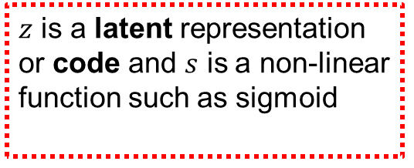

Autoencoder
Learn the functions $f$ (encoder) and $g$(decoder) from a given data $x$ (no labels)
$f\left(x\right)=s\left(wx+b\right)=z$
and
$g\left(z\right)=s\left(w^{′}z+b^{′}\right)=\hat{x}$
s.t $h\left(x\right)=g\left(f\left(x\right)\right)=\hat{x}$
where $h$ is an approximation of the identity function.
$$x$$
$$f\left(x\right)$$
$$z$$
$$g\left(z\right)$$
$$\hat{x}$$
$z$ is a latent representation or code and $s$ is a non-linear function such as sigmoid
$\hat{x}$ is $x$’s reconstruction

Slide 61

Training autoencoder
Using Gradient Descent to train the model
Squared error loss function
$L\left(x,\hat{x}\right)={\left\|x−\hat{x}\right\|}^{2}$
Cross entropy loss function if the input is interpreted as bit vectors or vectors of probabilities
$H\left(p,q\right)=−\sum_{x}{p\left(x\right)\log{q\left(x\right)}}$

Slide 62
Undercomplete and overcomplete autoencoder
Undercomplete Overcompelete

Slide 63





Undercomplete autoencoder
Hidden layer is Undercomplete if smaller than the input layer
Compresses the input
Compresses well only for the training distribution
Hidden nodes will be
Good features for the training distribution
May be bad for other types of input
$$\hat{x}$$
$$w′$$
$$f\left(x\right)$$
$$w$$
$$x$$

Slide 64





Overcomplete encoder
Hidden layer is Overcomplete if greater than the input layer
No compression in hidden layer.
Each hidden unit could copy a different input component
No guarantee that the hidden units will extract meaningful structure
A higher dimension code helps model a more complex distribution
$$\hat{x}$$
$$w′$$
$$f\left(x\right)$$
$$w$$
$$x$$

Slide 65


Slide 66

Convolutional AE

Slide 67
Numerosity Reduction
Parametric methods
Assume the data fits some model, estimate model parameters, store only the parameters, and discard the data (except possible outliers)
Non-parametric methods
Do not assume models
Major families: histograms, clustering, sampling

Slide 68
Regression Model
Linear regression: Data are modeled to fit a straight line
Often uses the least-square method to fit the line
Multiple regression: allows a response variable Y to be modeled as a linear function of multidimensional feature vector

Slide 69
Regress Analysis Model
Linear regression: Y = α + β X
Two parameters , α and β specify the line and are to be estimated by using the data at hand.
using the least squares criterion to the known values of Y1, Y2, …, X1, X2, ….
Multiple regression: Y = b0 + b1 X1 + b2 X2.
Many nonlinear functions can be transformed into the above.

Slide 70
Histograms
A popular data reduction technique
Divide data into buckets and store average (sum) for each bucket
Can be constructed optimally in one dimension using dynamic programming
Related to quantization problems

Slide 71
Clustering
Partition data set into clusters, and one can store cluster representation only
Can be very effective if data is clustered but not if data is “smeared”
Can have hierarchical clustering and be stored in multi-dimensional index tree structures
There are many choices of clustering definitions and clustering algorithms

Slide 72
Sampling
Allow a mining algorithm to run in complexity that is potentially sub-linear to the size of the data
Choose a representative subset of the data
Simple random sampling may have very poor performance in the presence of skew
Develop adaptive sampling methods
Stratified sampling:
Approximate the percentage of each class (or subpopulation of interest) in the overall database
Used in conjunction with skewed data

Slide 73

Sampling
Raw Data
Stratified Sample

Slide 74
Discretization and Concept Hierachy
Discretization
reduce the number of values for a given continuous attribute by dividing the range of the attribute into intervals. Interval labels can then be used to replace actual data values.
Concept hierarchies
reduce the data by collecting and replacing low level concepts (such as numeric values for the attribute age) by higher level concepts (such as young, middle-aged, or senior).

Slide 75

Entropy-Based Discretization
Given a set of samples S, if S is partitioned into two intervals S₁ and S₂ using boundary T, the entropy after partitioning is
$$E\left(S,T\right)=\frac{|S_{1}|}{|S|}E\left(S_{1}\right)+\frac{|S_{2}|}{|S|}E(S_{2})$$
The boundary that minimizes the entropy function over all possible boundaries is selected as a binary discretization.
The process is recursively applied to partitions obtained until some stopping criterion is met, e.g.,
$$E\left(S\right)−E\left(S,T\right)<δ$$
It may reduce data size and improve classification accuracy

Slide 76

Entropy
Entropy
$$E(P)=−\sum_{i=1}^{n}{p_{i}log⁡(p_{i})}$$
KL (Kullback-Leibler) divergence
$$D_{KL}(P||Q)=−\sum_{i=1}^{n}{p_{i}log⁡(\frac{q_{i}}{p_{i}})}$$
$\text{Cross}\text{−}\text{entropy}$
$$CE(P,Q)=−\sum_{i=1}^{n}{p_{i}log⁡(q_{i})}$$
$CE(P,Q)= E(P)$+ $D_{KL}(P||Q)$
P：probability distribution of ground-truth, Q: probability distribution of predicted
Notes:
Entropy: amount of information to remove uncertainty. For example, “A will die in 500 years old” (certain, less information) “A will die in 50 years old” (more information to remove uncertainty)
P: probability distribution of ground-truth, q: predicted probability of predicted E(P) is a constant for a given dataset. https://stats.stackexchange.com/questions/357963/what-is-the-difference-cross-entropy-and-kl-divergence
If the predictions are perfect, that is the predicted distribution is equal to the true distribution, then the cross-entropy is simply equal to entropy. But, if the distributions differ, then the cross-entropy will be greater than the entropy by some number of bits. This amount by which the cross-entropy exceeds the entropy is called the Relative Entropy or more commonly known as the Kullback-Leibler Divergence (KL Divergence).

Slide 77
Concept Hierarchy Generation for Categorical Data
Specification of a partial ordering of attributes explicitly at the schema level by users or experts
street<city<state<country
Specification of a portion of a hierarchy by explicit data grouping
{Urbana, Champaign, Chicago}<Illinois
Specification of a set of attributes.
System automatically generates partial ordering by analysis of the number of distinct values
E.g., street < city <state < country
Specification of only a partial set of attributes
E.g., only street < city, not others

Slide 78
Summary
Data preparation is a big issue for both warehousing and mining
Data preparation includes
Data cleaning and data integration
Data reduction and feature selection
Discretization
A lot a methods have been developed but still an active area of research

